Slide 1
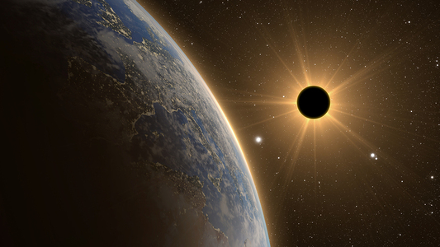
The Impact & Importance of Science Writing
Stephanie Martinez

Slide 2

Introductions
Stephanie Martinez – NASA Space Grant Science Writing Intern
MENTOR: Chris Etling – Managing Editor with the Arizona Daily Sun

Slide 3
Goals
Focusing and gaining understanding of a diverse range of scientific events, discoveries, and accomplishments.
Translating scientific details and technicalities into a generally comprehensive format for any general audience.

Slide 4
Initial Publication
First publication through the internship featured two articles.
One of the articles featured details and highlights of the Flagstaff Festival of Science.
The other article focused more on the specific keynote presentation, given by paleontologist Dr. Christa Sadler.
In her presentation, Dr. Sadler herself mentions the importance of science writing.

Slide 5
“I think writing is just really incredibly important. Reading and writing go together. If you’re reading all of this information about your particular science, then that informs your writing and vice versa. People think there’s not a connection between the two. That if you’re a scientist you’re just doing math and working with test tubes. But writing is always incredibly important to be able to communicate your science.”
- Dr. Christa Sadler

Slide 6
Diversity in Subjects
Other topics covered among my articles include the following:
Monthly Astronomy Events
Mars Rover Landing
Research work among local scientists

Slide 7
Why Science Writing is Important
Provides additional support from both science enthusiasts, as well as the general public
Allows everyone and anyone to share in the joy of the latest scientific discoveries
What people know, and how much they understand it, greatly influences just how much support a project or discovery can obtain
Support can come in many forms including funding and resource availability.
Sharing knowledge can also be a form of working together to accomplish something.

Slide 8
Conclusion
The overall importance and impact of science writing does not come directly from the science itself, rather the ability to relay the marvels and incredibility of what scientists have learned and what they are in process of discovering. Through science writing, humankind can further progress in learning all that we can.

